Slide 1
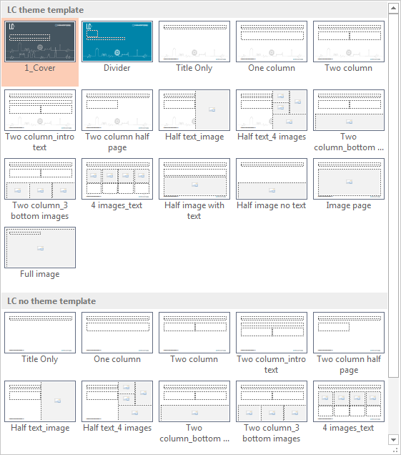
ZiBRA project: real-time sequencing of Zika virus in Brazil
REAPPLYING THE SLIDE LAYOUT
Putting text into a placeholder not only ensures the text sits in the correct place and is formatted correctly, it also helps to update the page quickly and efficiently.
Right click on any part of slide
Click on ‘Layout’
Select the layout you require
Nuno Rodrigues Faria, University of Oxford
with Josh Quick and Nick Loman, University of Birmingham
26 May 2016

Slide 2
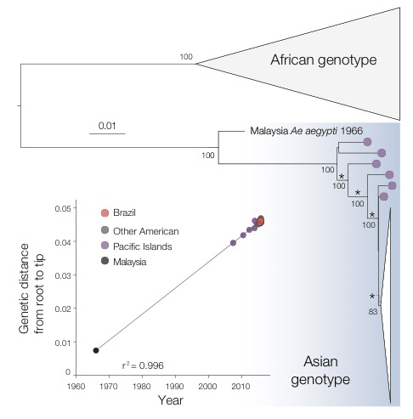
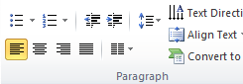
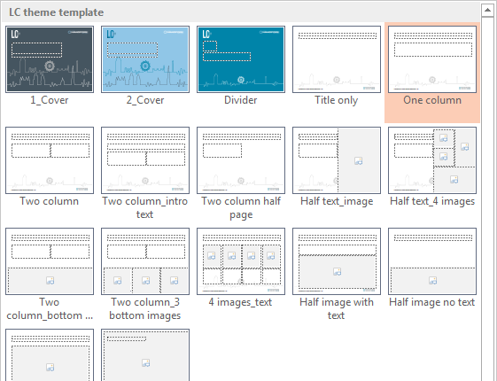

Zika virus in the Americas
FORMAT TEXT LEVELS IN THE PLACEHOLDERS
To use text/bullet formatting levels correctly, use the Increase List Level and Decrease List Level buttons from the Paragraph group on the Home tab.
Alternatively you can use the keyboard shortcuts: Shift+Alt+Right arrow key = increase level Shift+Alt+Left arrow key = decrease level.
Early epidemiological findings
Very brief history
Zika virus isolated from sentinel monkeys in the Zika forest, Uganda in 1947
Transmitted via Aedes aegypti that is also the main vector of DENV, CHIKV and YFV
Flavivirus with single stranded RNA genome of 11kb
Two phylogenetic genotypes: African and Asian
Mild, febrile illness; only 16 cases until 2007
Yap Islands (2007), French Polynesia (2013-14), New Caledonia (2014), Easter Island (2014), Samoa (2015)
Circulation of the ZIKV Asian genotype in Bahia, northeast Brazil confirmed in March 2015
Increase in microcephaly cases noted in October 2015
REAPPLYING THE SLIDE LAYOUT
Putting text into a placeholder not only ensures the text sits in the correct place and is formatted correctly, it also helps to update the page quickly and efficiently.
Right click on any part of slide
Click on ‘Layout’
Select the layout you require
Kraemer et al. eLife 2015

Slide 3
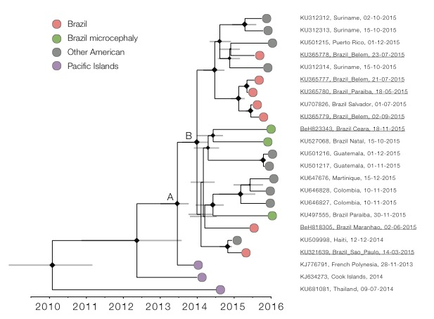
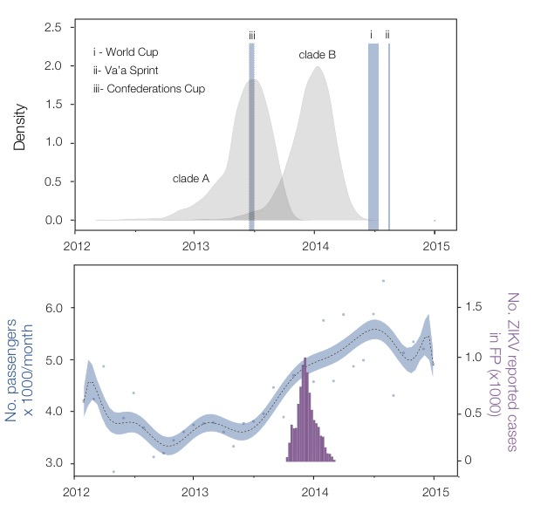
Single introduction of Zika virus in the Americas
Large scale mobility patterns and the ignition of ZIKV in Brazil
At least 12 months earlier before its first detection
Kraemer et al. eLife 2015
Faria et al. Science 2016

Slide 4
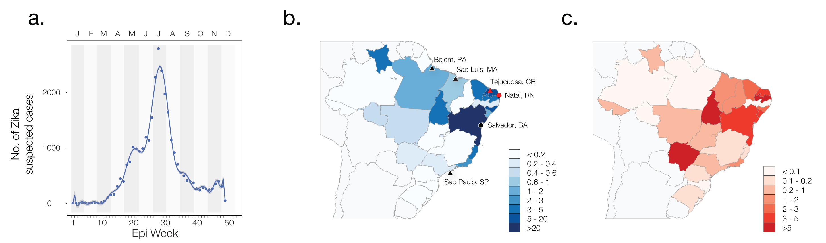
Zika virus and microcephaly incidence in Brazil
Zika incidence highest in Northeast of Brazil, particularly in the Bahia state (under-reporting and misclassification)
Over 1,434 confirmed (3,257 suspected) microcephaly cases, 76% in Northeast of Brazil (as of 25 May 2016)
Zika virus causes birth defects (Rasmussen et al., NEJM ,19 May 2016)
A public health emergency of international concern - WHO, 1 February 2016
Notified Zika cases in 2015
Zika incidence per 100,000 in 2015
Microcephaly incidence per 100,000 in 2015
Faria et al. Science 2016

Slide 5
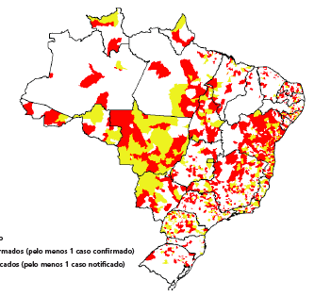
Zika virus genomic surveillance data is remarkably scarce
Zika virus Asian genotype genomes published in Genbank as of 25 May 2016
Brazil has the highest number of notified ZIKV cases in the Americas (PAHO, 19 May 2016)
DENV (2016: 1,054,127 cases), ZIKV and CHIKV (64,349) co-circulate in all Brazil (Boletim Epi16, 23 March 2016)
Municipalities w/confirmed cases
#Asian genotype genomes
Brazil (n=24)
Municipalities w/suspected cases
Americas (n=25)
Pacific Islands (n=8)
No data
Zika Virus
120,161 cases
< 0.001 % sequenced
Per time window

Slide 6
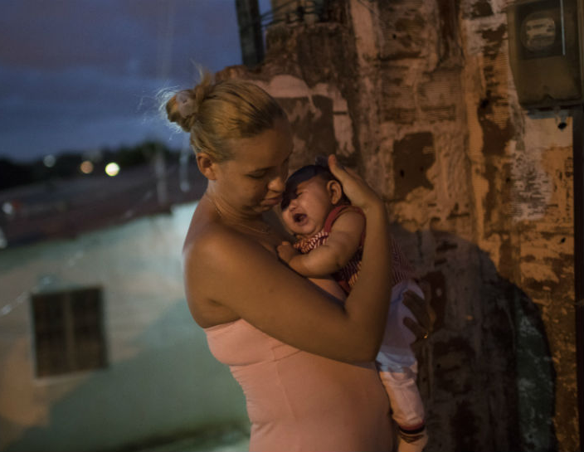
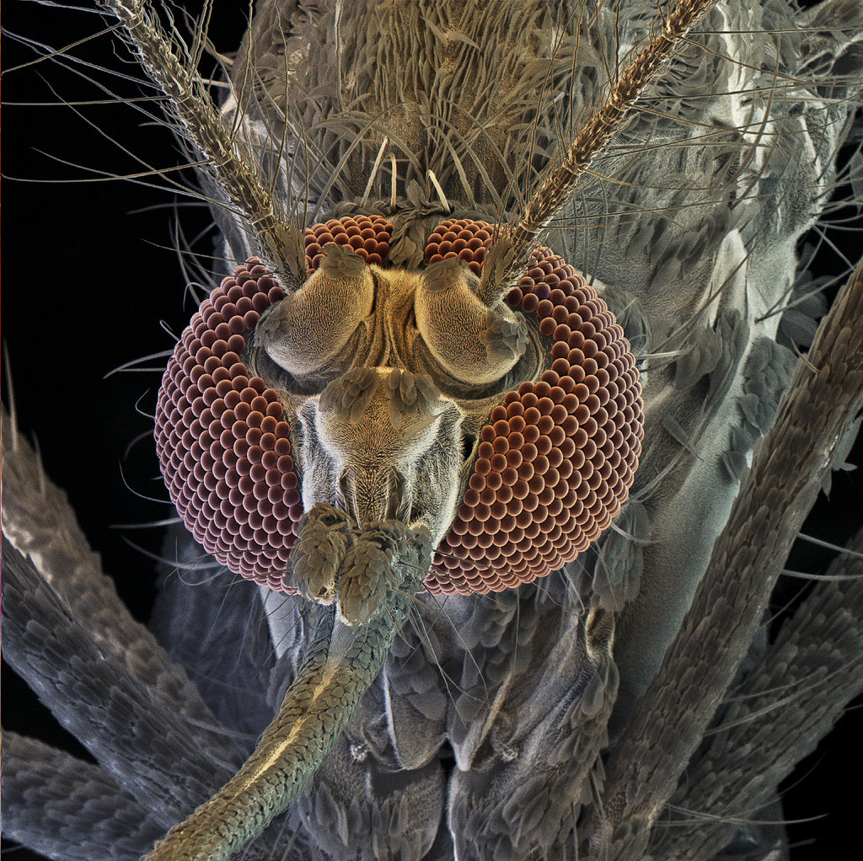
Introducing ZiBRA goals
Main objectives
Covering a broad geographical region including historical samples, patients with a range of clinical presentations and samples from Aedes mosquitoes.
When, where and how did ZIKV become established in Brazil?
What are the patterns and drivers of local, regional and international spread? Spatiotemporal predictions
What is the extent of virus genetic diversity? Vaccine and diagnostic design
Are there associations between changes in the virus genome and the likelihood of ZIKV complications such as microcephaly?
Is there a link between dengue pre-exposure and ZIKV caused microcephaly?
Mother with microcephaly
Newborn (by Felipe Dana)
Surveillance framework for tracking future spread into other geographic regions.
A beacon for open science during a public health emergency - data will be subject to open release in Virological.org as it is generated.
Aedes aegypti
Mosquito (by David Scharf)

Slide 7
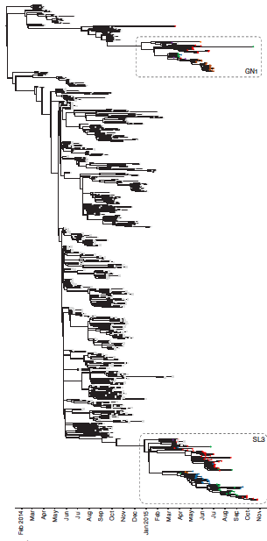
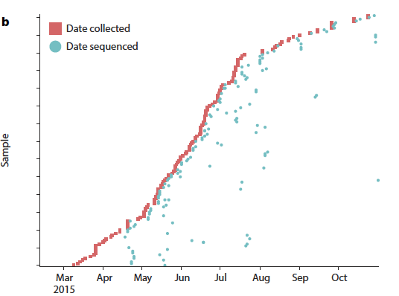
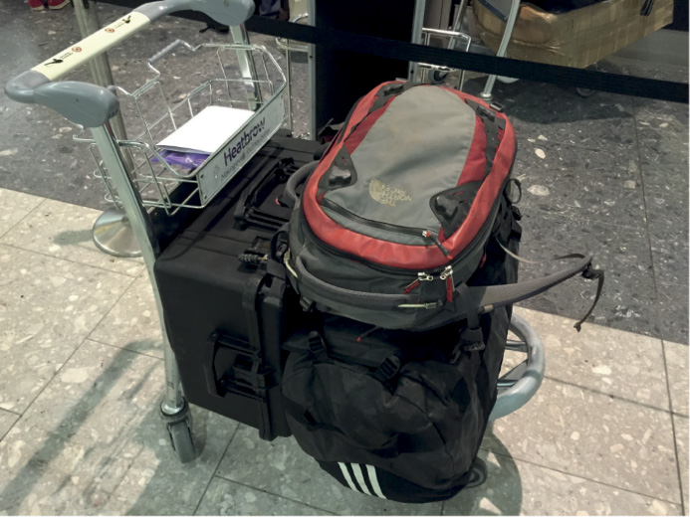
Real-time sequencing using MinION
Tailored approach to amplify ZIKV, DENV, CHIKV and YFV
Building upon experience in virus outbreak sequencing in Guinea
Josh Quick, Nick Loman et al., Real-time portable sequencing for Ebola surveillance, 2016 Nature 530:228-232.

Slide 8
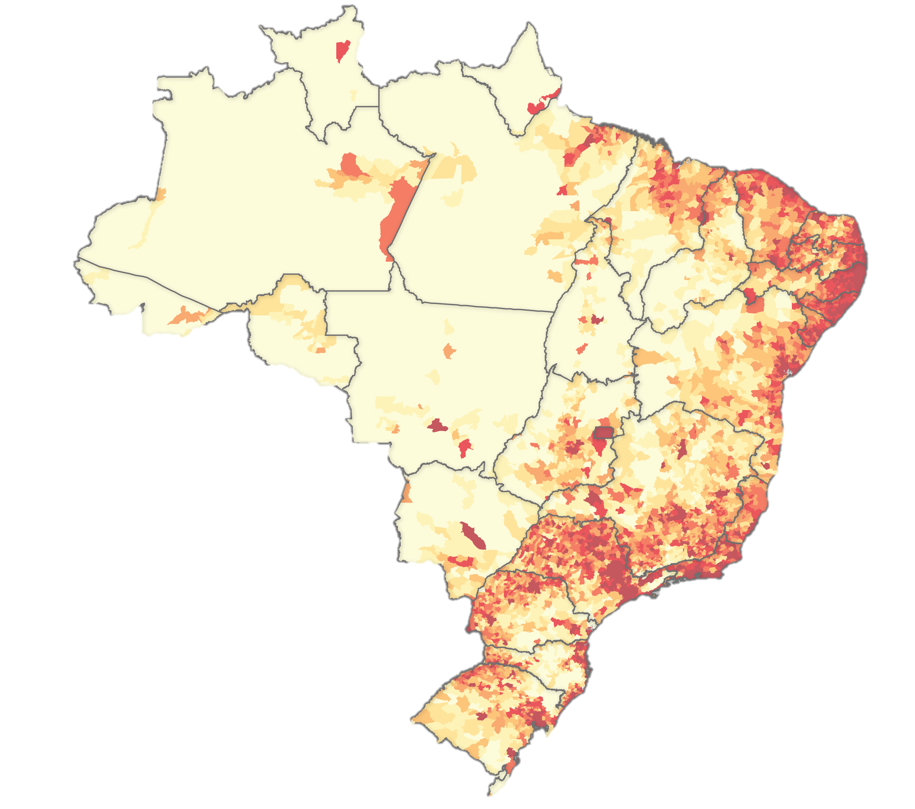

ZiBRA project – a sequencing road trip through incidence hotspots
Instituto Evandro Chagas
D1 Belém*
Key stops in LACENs
Joint coordination efforts with Brazilian Ministry of Health (epidemiological data)
Sequencing 750 FG human samples:
RT-PCR ZIKV+
RT-PCR Dengue+
RT-PCR Chikungunya +
Team of entomologists from IEC to collect mosquito populations
Materials that arrived to Brazil
Qiagen QiaCube RNA Extractor
4 Oxford Nanopore MinION Mk1b
96 Oxford Nanopore R9 Flowcells
17 Oxford Nanopore NSQ-MAP007
7 Oxford Nanopore Barcode kits
FioCruz Bahia Salvador* D18
University of São Paulo
São Paulo
Fixed laboratory
Adapted from
Kraemer et al. eLife 2015
*fixed laboratories after mid June 2016

Slide 9
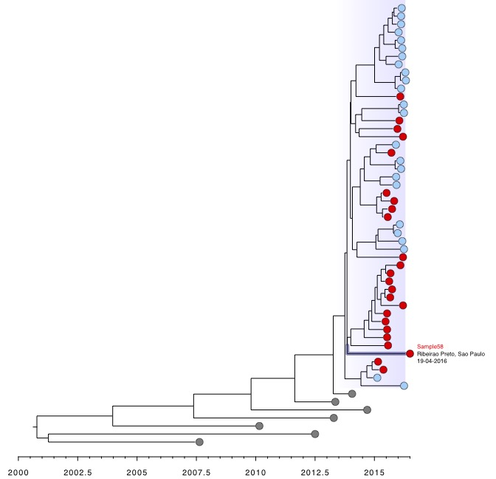
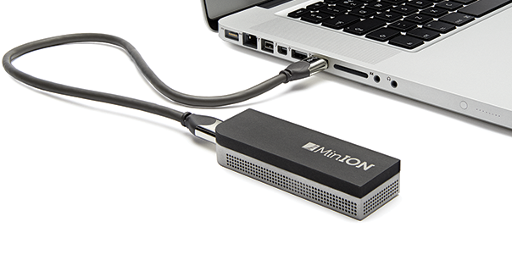
ZiBRA project – a sequencing road trip through incidence hotspots
Multiplex PCR
Dated phylogeny with Sample58 collected in Ribeirao Preto, Sao Paulo
Sample58 seems to be the ancestor of clade C (Naccache et al. 2016)

Slide 10

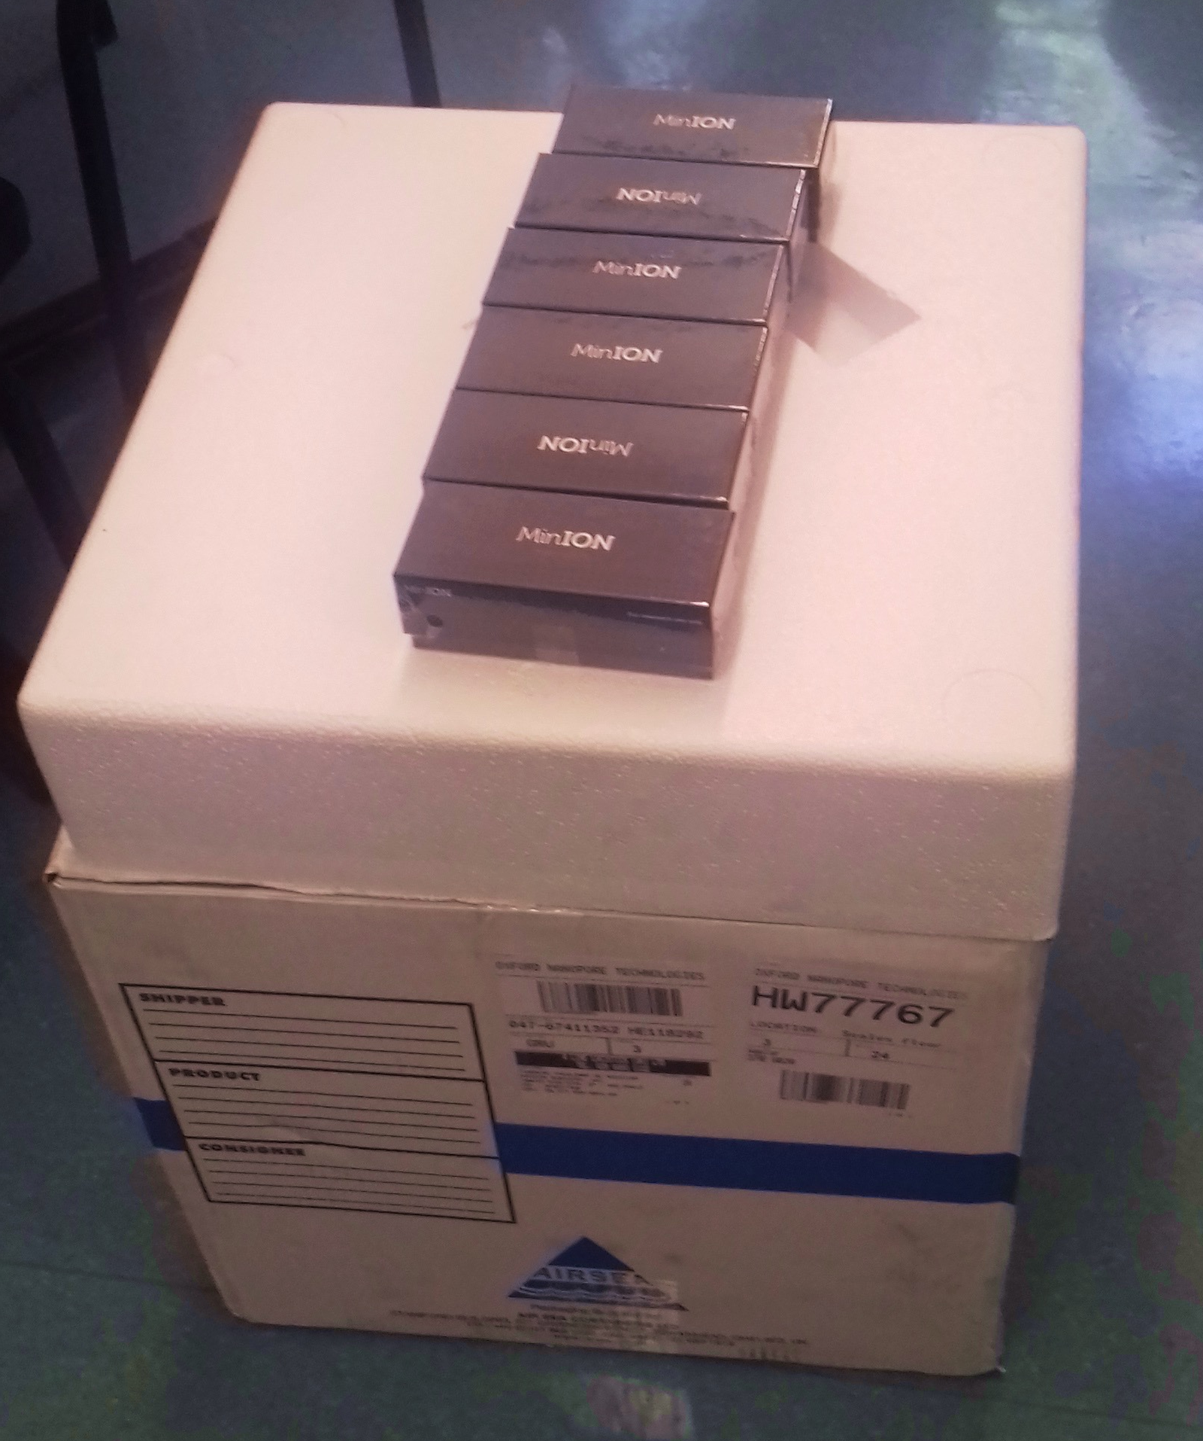
International long-term collaboration
http://zibraproject.github.io
virological.org
nexstrain.org/zika
Oxford Nanopore
Everyone
Instituto Evandro Chagas
Marcio Nunes (Co-PI)
Joao Vianez
Luciano Franco
Sandro Patroca
Poliana da Silva Lemos
University of Birmingham
Nick Loman (PI)
Josh Quick
University of Oxford
Nuno Faria (Co-PI)
Oliver Pybus (Co-PI)
Paul Klenerman (Co-PI)
FioCruz Bahia
Luiz Alcantara (Co-PI)
Marta Giovanetti
Jacqueline de Jesus
University of Edinburgh
Andrew Rambaut (Co-PI)
University of Sao Paulo
Ester Sabino (Co-PI)
Antonio Charlys da Costa
Ingra Morales
Public Health England
Miles Carroll (Co-PI)
University of Sidney
Eddie Holmes (Co-PI)
Fred Hutchinson
Trevor Bedford
24 May 2016
Oxford Nanopore arrived at São Paulo
University of Nottingham
Matt Loose (Co-PI)
Ontario Inst. Cancer Research
Jared Simpson (Co-PI)
Particularly to Rosemary and Oli

